Slide 1

Ever felt lost in the huge campus of your own college?
We've all been there!

Slide 2

Everything was shared in the orientation but you don’t remember?
Let us tell you about the reality.

Slide 3
Here are some problems faced by freshers instantly after joining college
When you get your schedule, you don’t know where is LA1 or LA2.
Where you have to go for your electronics problems (like for new speakers or router).
Where to go for a haircut?
If you feel sick, where is the nearest doctor?

Slide 4
The Solution?

Slide 5
Know Your College
A website exclusively for freshers coming to NIT Rourkela for the first time.

Slide 6
The Website
Don't know where you are? Where to go? How to go? The very personalized map of only NIT Rourkela is at your service.
Mess food is not good? Wanna have a party with friends? The Food webpage shows you where to go. And yes, it shows the direction to that place too.
Not a person who reads news regularly? Don't worry, the News is served up to you in a very aesthetic manner.

Slide 7
The Website
Don't know where to attend your classes? Orientation is held in BBA, but WHERE IS BBA? For that we have our Academic_Area page.
You also like to keep yourself healthy? Come and play any sport of your choice. Where? Here.
Got settled? Very nice. But you need a haircut once in a while. Or maybe your cycle got a flat tire. The Essentials page is here to help.
Found some bug in the website? Something wrong from our side? Go to the Suggestions page and write to us.

Slide 8
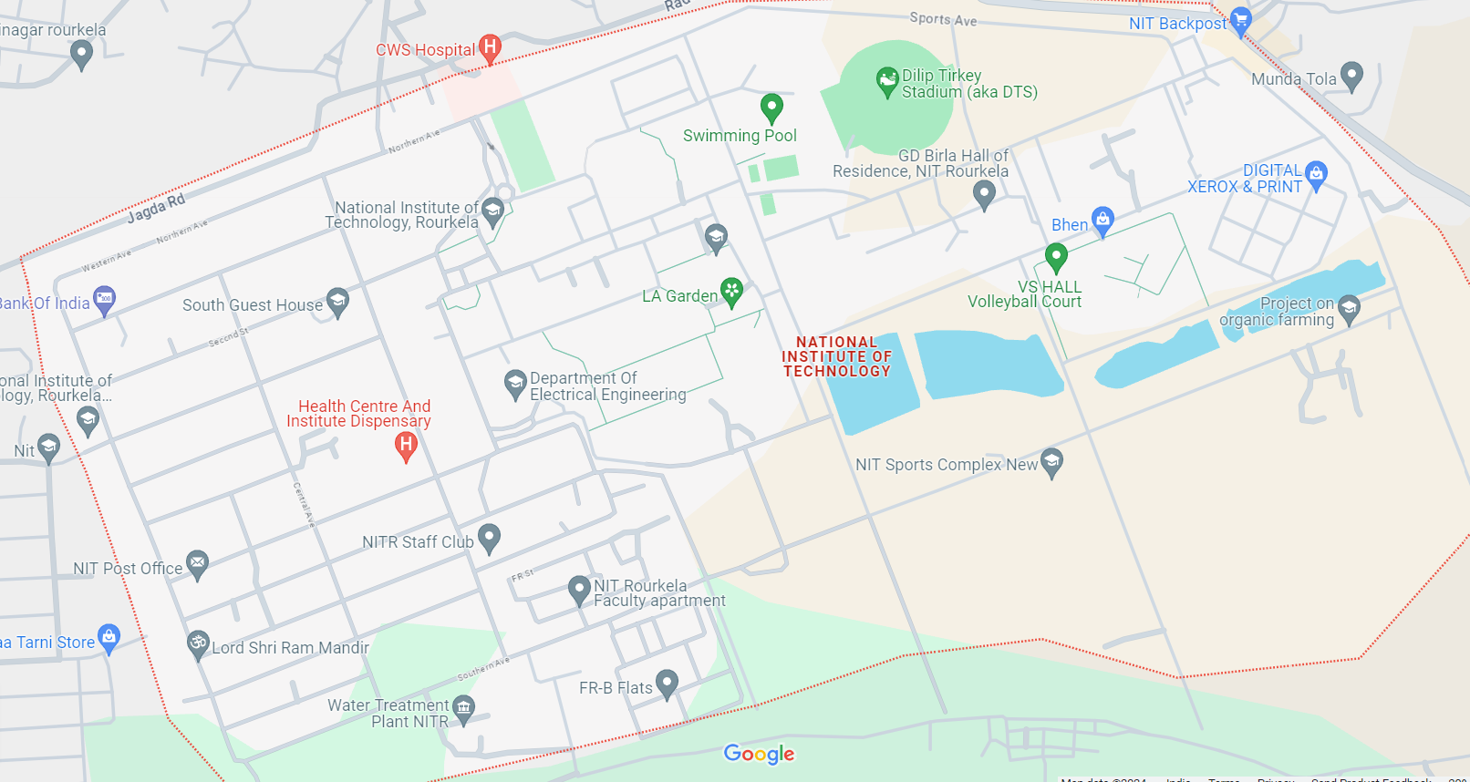
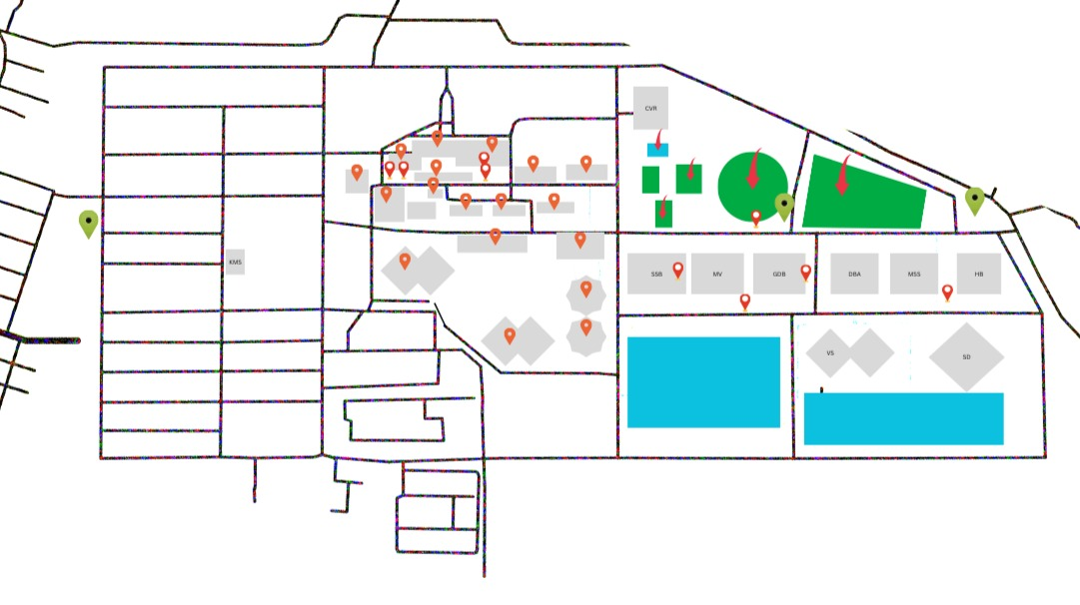
How is it different from Google Maps?
Google maps
HaTMiLon
Frankly, Google Maps is misleading!

Slide 9
Impact and sustainability
This product will help the freshers to get used to college life much better.
This idea is not only viable for NIT Rourkela alone, every college can attempt to make it. It would be better if it is made by the students because they know the problems face by them.
Since the project is Open-Source, and a suggestions page has also been added, we believe there should not be lack of ideas or inspiration.

Slide 10
Future plans
This website can become the official NITR website for any information from student side.
Among the various webpages, a webpage informing students about the different clubs can also made. Same can be done for all the fests being organized in NIT R.
This same idea and website can be converted into a mobile app; so that students can access it without the internet.

Slide 11
Tech Stack used
Website
For the most parts, basic HTML is used
For the designing parts, Vanilla CSS is used
For the News and Academic_Area webpage, Javascript is also used
The website is deployed using Github pages.
It is live at https://abarpanda.github.io/HaTMiLon

Slide 12
THANK YOU
From Team HaTMiLon
Members- Amritanshu Barpanda, Bidyendu Das, P. Amrita, Anish Samal

